Slide 1
Acceleration
Fastest Man on Earth

Slide 2
Get an Ipad, from my website click on Acceleration web notes on today’s calendar. Answer the following questions:
What is acceleration?
Why is acceleration a vector quantity?
What does a position vs. time graph look like when showing changing velocity?
What is constant acceleration?
What are the units for acceleration?
What is the equation for finding average acceleration?
Explain how acceleration can be both positive and negative.

Slide 3
Acceleration
Acceleration is a vector which measures the change in the velocity of an object.
It has magnitude and direction.
This means acceleration could be any of the following three…
1. a change in speed, the magnitude of the velocity (from 34 km/h to 67 km/h)
2. a change in direction (from East to North- East)
3. a change in both speed and direction (from 34km/h East to 12 km/h West)

Slide 4
Acceleration
When an object has acceleration, it covers a different distance each second it is in motion.
Remember: Constant velocity means an object in motion covers the same distance each second it is in motion.

Slide 5
Which car or cars (red, green, and/or blue) are undergoing an acceleration? Study each car individually in order to determine the answer.
Which car (red, green, or blue) experiences the greatest acceleration?

Slide 6
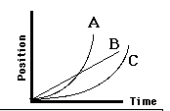
Consider the position-time graph below. Each one of the three lines on the position-time graph corresponds to the motion of one of the three cars. Match the appropriate line to the particular color of car.

Slide 7
Graphing
Remember: A position vs. time graph that shows a constant velocity has a linear slope
A position vs. time graph that shows a changing velocity has a curved slope.

Slide 8
Velocity- Time Graphs Notes
A velocity time graph tells us the speed of an object in a given period of time and is based on position time data.
The slope of a velocity time graph is acceleration.
The graph also gives a picture of the initial and final velocity of an object

Slide 9
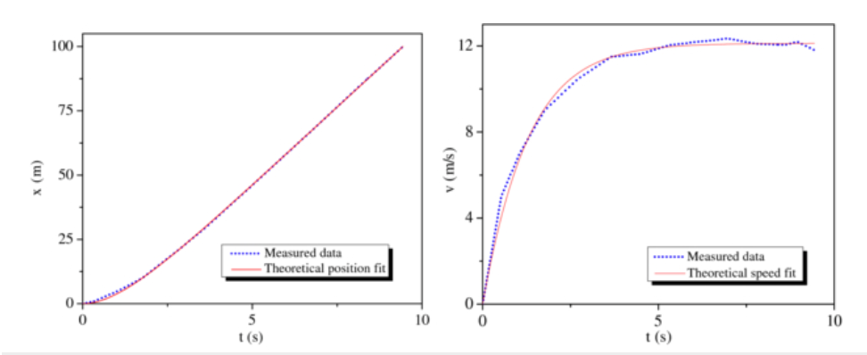
Usain Bolt 12.2 m/s or 27 mph

Slide 10
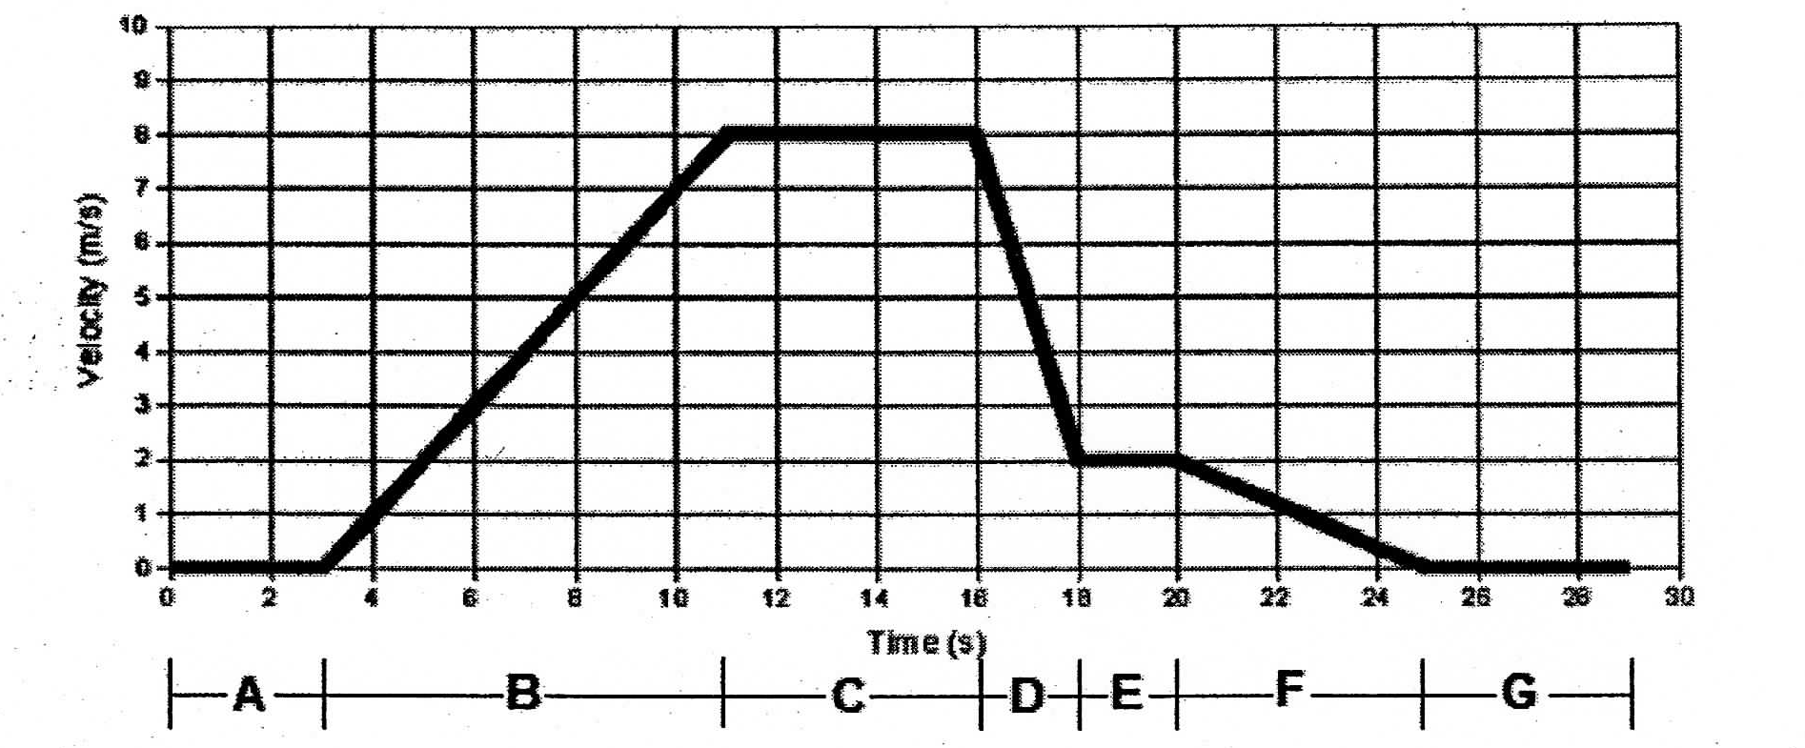
Understanding Velocity Time Graphs

Slide 11
Constant Acceleration
Occurs when an accelerating object changes its velocity by the same amount each second
An object with a constant acceleration should not be confused with an object with a constant velocity
If the velocity is changing, then the distance traveled/time is not a constant value

Slide 12
Average Acceleration
Acceleration is the rate at which velocity changes
A rate quantity means that time is in the denominator
a = acceleration
v_{f}= final velocity
v_{i} = initial velocity
t = time

Slide 13
Acceleration Units
Units for velocity
m/s
Km/h
Acceleration is velocity/time so units include
m/s/s or m/s²

Slide 14
Direction of Acceleration
Direction depends on two things
If the object is speeding up or slowing down
If the object is moving in a positive or a negative direction
Acceleration is positive when . . .
The object is speeding up
The object is moving in a positive direction (forward)
Acceleration is negative when . . .
The object is slowing down
The object is moving in a negative direction (backward)

Slide 15
Example
A bus traveling at 30 km/h speeds up at a constant rate of 3.5 m/s². What velocity does it reach 6.8 seconds later?
How can we rearrange this equation to solve for v_{f}?

Slide 16
Kinematic Equations
We can use variations of the basic velocity equation and solve for the variables time, final velocity, initial velocity, distance, and acceleration.
Foldable Instructions

Slide 17
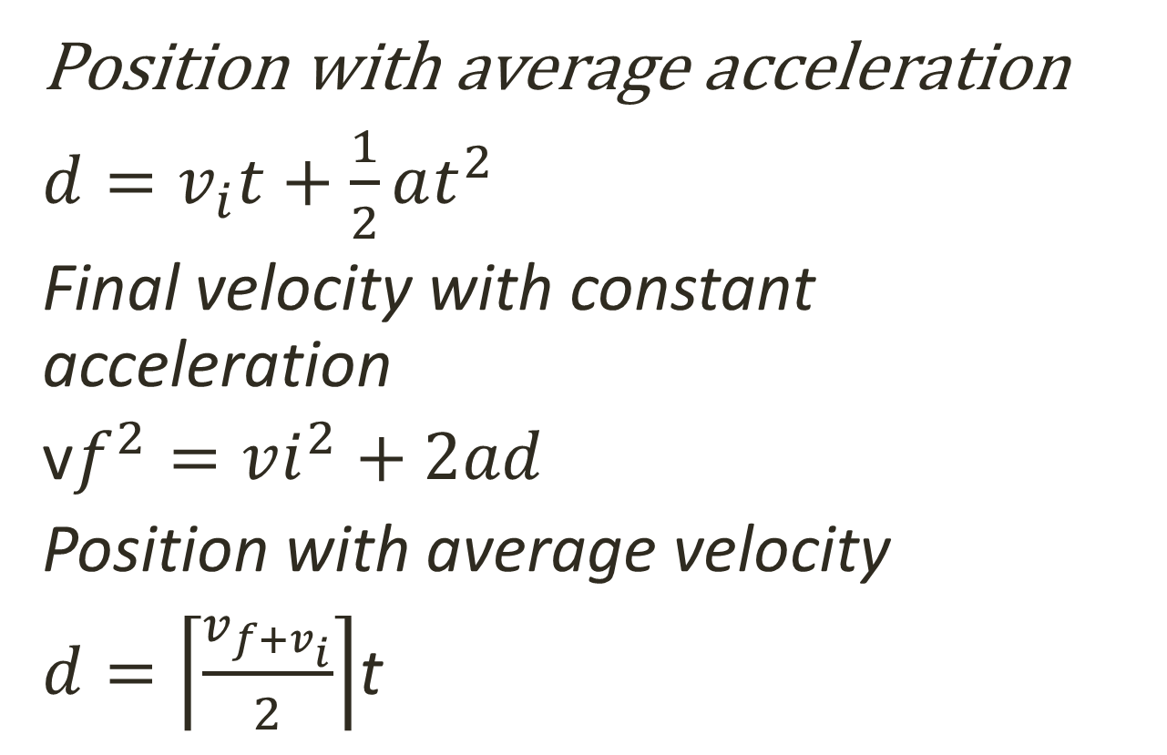
Useful Equations

