Slide 1
Bellwork:
Pick up the notes from the back
Using the QR code, link to the Word wall and answer the question at the top- “What do you think the word momentum means?”

Slide 3
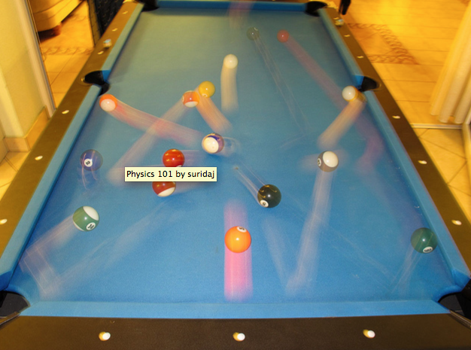

Slide 4
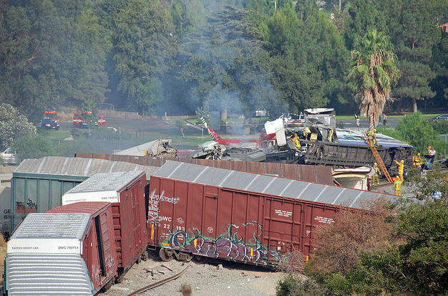

Slide 6
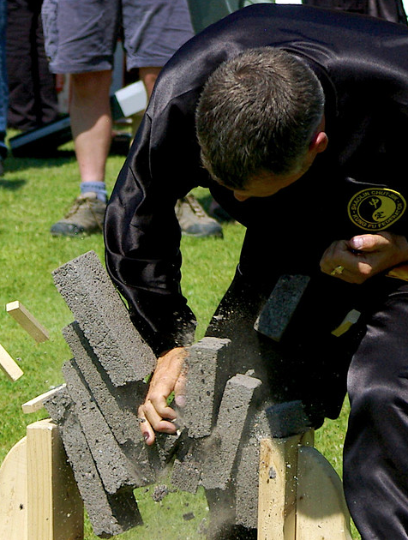

Slide 7
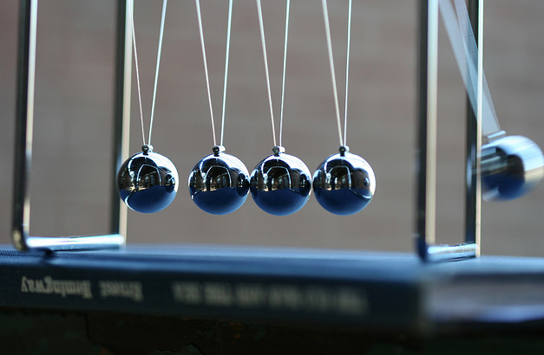

Slide 8
Momentum and Newton’s 3rd Law
http://nbclearn.com/nfl

Slide 9
What is momentum?
http://www.youtube.com/watch?v=yUpiV2I_IRI (5:50)
The quantity of motion an object has
If an object is in motion, it has momentum
Mass in motion

Slide 10
Examples
Hitting a pool ball, golf ball
catching a base ball
car accidents
Any type of collision

Slide 11
Momentum
Momentum is a vector quantity
Is dependent on 2 things:
How much “stuff” is moving, Mass, measured in kg
How fast the stuff is moving, Velocity, measured in m/s

Slide 12
To determine momentum . . .
p = mv
Momentum = mass x velocity
Measured in kg• m/s

Slide 13
Determining Momentum
Momentum is large if either the mass or the velocity of an object is large
If a large mass is at rest, it has no momentum
If a small mass is moving quickly, it can have great momentum

Slide 14
Mass and Momentum
Can a fast car have more momentum than a slow truck?
Can a roller skate have more momentum than a large truck?

Slide 15
Example 1
Determine the momentum of a ...
a. 60-kg halfback moving eastward at 9 m/s.
b. 1000-kg car moving northward at 20 m/s.
c. 40-kg freshman moving southward at 2 m/s.

Slide 16
IMPULSE

Slide 17
Momentum Bell work- Day 2
A compact car, mass 725 kg, is moving at a speed of 100 km/h.
What is the car’s momentum?
At what velocity is the momentum of a larger car, mass 2175 kg, equal to that of the smaller car?

Slide 18
Review
Momentum is “mass in motion”
It takes a force to change an object’s velocity (Newton’s 1st law)
If velocity changes, momentum changes
P=mv

Slide 19
Science of Speed
http://www.nsf.gov/news/special_reports/sos/momentumtime.jsp

Slide 20
Changing Momentum
What do we already know from Newton’s 1st law of motion?
It takes a force to stop an object in motion
It takes force to change an object’s momentum
You will need to apply the force over a period of time to stop the object

Slide 21
Momentum and Newton’s 2nd Law
Applying a force over a period of time will change the object’s momentum
Causes a change in acceleration (slowing down)
Which causes a change in velocity, therefore a change in momentum

Slide 22
Impulse
A change in momentum, caused by a force, over a period of time
Is large if the force acts over a long period of time
Is small if the force acts over a short period of time

Slide 23
Equation

Slide 24
Impulse
Measured in Ns

Slide 25
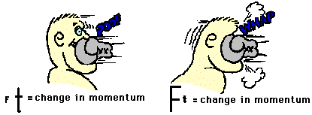
Changing Momentum

Slide 26
Increasing the TIME of impact decreases the FORCE of impact
Ft = change in momentum

Slide 27
Decreasing the TIME of impact increases FORCE of impact
Ft = change in momentum

Slide 28
Example 2
What is the momentum of a golf ball with a mass of 62 g moving at 73 m/s? If the impact between the ball and club lasted for 0.002 s, what force acted on the ball? What force acted on the club?

Slide 29
Egg Demo

Slide 30
Bellwork: Complete the question below.
A 2200 kg vehicle traveling at 26 m/s can be stopped in 21 s by gently applying the brakes. It can be stopped in 3.8 s if the driver slams on the brakes, or in 0.22 s if it hits a concrete wall. What force is exerted on the vehicle in each of these stops?

Slide 31
Conservation of Momentum

Slide 32
Bellwork
Take out your notes and pick up your iPad
Complete the Impulse quiz using the QR code found on your notes
http://www.youtube.com/watch?v=yUpiV2I_IRI
(7:37-12:23)

Slide 33
Conservation of Momentum
Applied to Newton’s 3rd law
Newton’s 3rd law: For every action there is an equal and opposite reaction
Remember, momentum is a VECTOR quantity!

Slide 34
Conservation
The momentum after a collision will be the same as before the collision
The force between two colliding objects is the same based on Newton’s 3rd law
Logically, the time two objects collide is equal (forces occur in pairs)
If the force and the time of collisions are equal and opposite, then the momentum before and after the collision must also be equal

Slide 35
Fish Catch Activity

Slide 36
Conservation of Momentum
The momentum lost by one object is gained by another object
This means the total amount of momentum is the same before and after a collision
Can only be assumed in an isolated system

Slide 37
Bellwork
Pick up iPad
Review notes for Quiz
When finished with quiz, finish Egg Drop Lab Write up
Complete Notes/Conservation of Momentum Activity

Slide 38
Isolated System
An isolated system is one in which
mass is not changed
There are no external forces (net force = zero)
In reality, forces like friction and air resistance are always present
This means the law of conservation of momentum is useful in approximating the total momentum conservation

Slide 39
Collisions Video
http://www.nbclearn.com/portal/site/learn/science-of-nhl-hockey

Slide 40
Elastic Collision
Collisions that collide without the objects being permanently damaged are called elastic collisions
When objects bounce perfectly, the collision is called perfectly elastic
No heat is generated
Example: billiard balls colliding on a pool table

Slide 41
Inelastic Collision
When objects collide and become tangled together, an inelastic collision occurs
Inelastic collisions produce heat
Example: a bullet becoming embedded in a tree

Slide 42
Bellwork
Pick up iPad
Review notes for Quiz
When finished with quiz, log onto Google Classroom and read the posted article OR finish Egg Drop Lab Write up
Complete Notes/Conservation of Momentum Activity

Slide 43
Conservation Equation
Final momentum is EQUAL to initial momentum
m₁v_{i} + m₂v_{i} = m₁v_{f} + m₂v_{f}

Slide 44
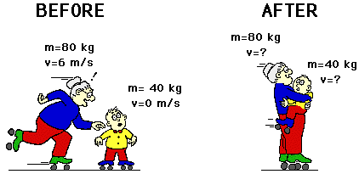
Calculate the momentum of granny and Waldo as they skate off together.

Slide 45
Example 1 answer

Slide 47
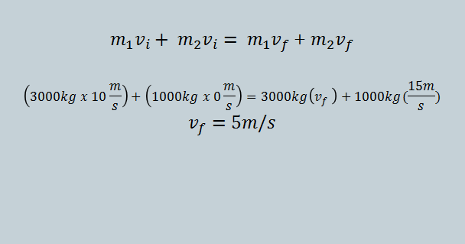
Example 2 answer

Slide 48
Jenny has a mass of 35.6 kg and her skateboard has a mass of 1.3 kg. What is the momentum of Jenny and her skateboard together if they are going 9.5 m/s?

Slide 49
A 1 kg dart moving horizontally at 10 m/s strikes and sticks to wood block of mass 9 kg, which slides across a friction free surface. What is the speed of the block and dart after collision? Assume the block was originally at rest.

Slide 50
Crash Worthiness -crash video footage
http://www.youtube.com/watch?v=yUpiV2I_IRI (15:40)

Slide 51
Egg Drop Lab
The Equipment: Each device may be made out of the following materials only! Scissors will be supplied.
10 Straws
1 m Thread
1 m Masking Tape
2 Sheets of 8.5” x 11” Notebook Paper

